Slide 1
SEC555
Presentation based on SEC555: SIEM with Tactical Analytics
Cloud Logging and Security
Justin Henderson (GSE # 108)
@SecurityMapper

Slide 2
About Me
Author of SEC555: SIEM with Tactical Analytics
GIAC GSE # 108, Cyber Guardian Blue and Red
61 industry certifications (need to get a new hobby)
Two-time NetWars Core tournament winner (offense)
And security hobbyist and community supporter
Collecting interns/contributors in bulk (research teams)
Release research to the community
See https://github.com/HASecuritySolutions

Slide 3
Welcome!
A copy of this talk is available at: https://github.com/HASecuritySolutions/presentations
More free stuff: https://github.com/HASecuritySolutions Disclaimer: This talk assumes you have familiarization with cloud technologies (at a basic level)

Slide 4

Cloud Logging
Many organizations struggle from lack of a definition
Cloud logging means too many things and is abstract
What does cloud logging mean?
Failed definition - To get logs from the cloud
Successful definition – Identifying and collecting data sources in the cloud that are worthy of analysis

Slide 5
Three Step Process
At a high-level, cloud logging is three steps
Discover
What data sources are available?
Why do they matter
Collect
Analyze
What data is in the logs?
How can the data be operationalized?
Discover
Analyze
Collect

Slide 6
Cloud Data Sources
There are multiple types of cloud services
Infrastructure-as-a-service (IaaS ) – Putting assets on someone else’s hardware
Platform-as-a-service (PaaS) – Using a third-party managed platform to organization applications
Software-as-a-service (SaaS) – Using software services developed and maintained by a third-party
Function-as-a-service (FaaS) – Using software as code capabilities to run and deploy applications on a third-party provider
Each has varying levels of data sources to collect. All have application logs
Responsibility

Slide 7
Scenario # 1 – Amazon AWS
Lab Me Inc. utilizes AWS for the following:
Tiered applications running as EC2 instances
Basic example: Nginx and MySQL
Some applications are running on Elastic Beanstalk
New applications are using containers in ECS/EKS
Developers are testing new web services using static sites, Lambda, Kinesis, and S3 buckets
IaaS -> EC2 Beanstalk -> PaaS Lambda -> FaaS

Slide 8

Focus Please
Pay attention to the data sources, not the how to collect
Discovery is about identifying what should be collected
At this stage you are documenting data sources you want

Slide 9
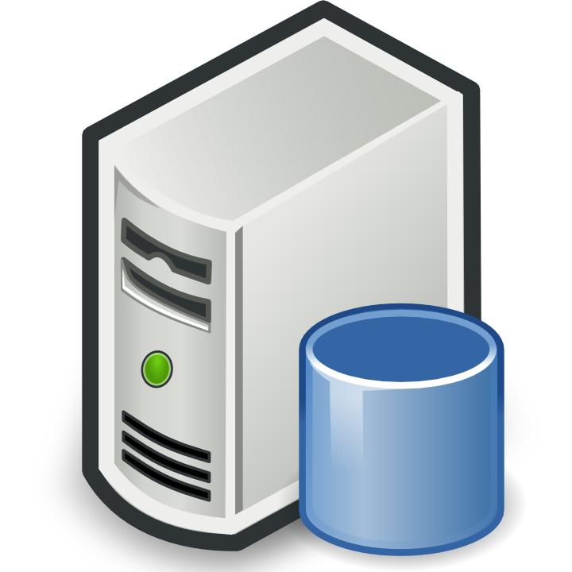
Amazon Application Data Sources
Consider Lab Me Inc’s two-tier web application
EC2 and Beanstalk - /var/log/nginx and /var/log/mysql
EKS - Amazon log driver to CloudWatch or via “sidecars”
Lambda and Kinesis - Functions log to CloudWatch / Kinesis to CloudTrail
Apache, Nginx,
and Lambda
MySQL, RDS,
and
Kinesis
Web
Database
Notes:
https://docs.aws.amazon.com/elasticbeanstalk/latest/dg/using-features.logging.html
https://theburningmonk.com/2017/08/centralised-logging-for-aws-lambda/

Slide 10

Amazon CloudTrail
CloudTrail provides a history of all actions taken against an Amazon tenant
Log in activity to Amazon Console
Creation, modification, or deletion of resources
Changes made to identity and management controls
CloudTrail is the data source for monitoring your tenant
Can export log to CloudWatch and/or S3 buckets
Notes:
https://docs.aws.amazon.com/awscloudtrail/latest/userguide/cloudtrail-event-reference-aws-console-sign-in-events.html

Slide 11
Scenario # 1 Data Sources
Data Source | What is it? | Purpose | Collection methods
CloudTrail | Tenant activity log for Amazon | Identify anomalous use within Amazon tenant | S3 bucket, CloudWatch
Nginx Web logs | Web server logs | Find attacks against web application or server Find logic attacks by baselining requests | Syslog, log agent, Amazon log driver to CloudWatch
MySQL Database logs | Database service logs and/or table containing logs of application activity | Find database attacks Baseline application activity and look for anomalies | Syslog daemon, log agent, database connection, Amazon log driver to CloudWatch, CloudWatch direct
Elastic Beanstalk | Logs of beanstalk provisioning and activity | Troubleshooting? | Syslog, log agent, S3, CloudWatch
Lambda | Logs function calls | Troubleshooting? | CloudWatch
Kinesis | Logs Kinesis interactions | Find abnormal requests | CloudTrail

Slide 12
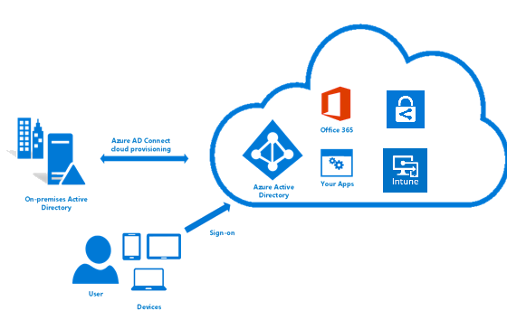
Scenario # 2 – Microsoft Azure
Lab Me Inc. utilizes Azure for the following:
Hosting Windows applications and services (such as IIS)
Office 365 for users (SharePoint, OneDrive, Exchange, and MS Teams)
Azure Active Directory with AD Connect
Azure Information Protection (AIP)
Microsoft Endpoint Manager
Mix of IaaS and SaaS

Slide 13

Azure Monitor
Two data types:
Metrics
Logs
Notes:
https://docs.microsoft.com/en-us/azure/azure-monitor/overview

Slide 14
Azure Applications
Azure Monitor provides tenant and Azure AD logs
Remaining data sources are SaaS/PaaS
Office 365 applications each have their own logs
SharePoint, OneDrive, Exchange, etc.
AIP logs to local clients and to Microsoft Storage Blobs
Endpoint Manager (Intune) logs to Azure Monitor
Also has client activity log, Event Hub, and Storage Blob

Slide 15
Scenario # 2 Data Sources
Data Source | What is it? | Purpose | Collection methods
Azure Monitor | Tenant activity log for Microsoft | Identify anomalous use within Microsoft tenant | Azure Monitor, Event Hubs
Office 365 | Office 365 application audit logs | Find unauthorized use or access requests Monitor sensitive data | Office 365 Management API
Azure Active Directory | Database service logs and/or table containing logs of application activity | Identity management auditing Identify anomalous log in attempts | Azure Monitor, Event Hubs
Azure Information Protection | Audit log of data access policies and file usage | Find improper data use and access attempts Log sensitive data locations | Storage Blob
Microsoft Endpoint Manager | Monitor endpoint asset management | Troubleshooting? | Azure Monitor, Event Hubs

Slide 16
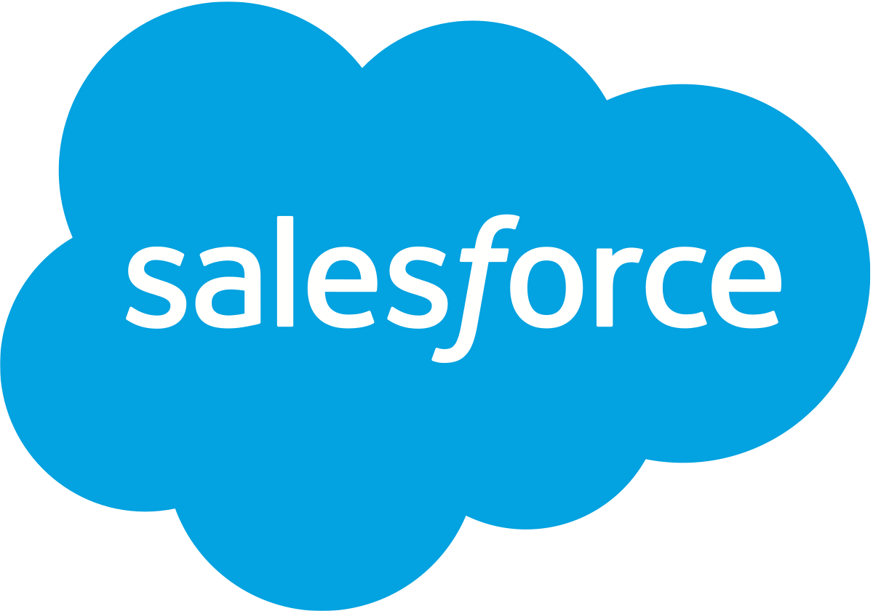

Scenario # 3 – DocuSign and Salesforce
Lab Me Inc also utilizes DocuSign and Salesforce
These are both common SaaS applications
Logging is proprietary via vendor APIs

Slide 17
Scenario # 3 Data Sources
Data Source | What is it? | Purpose | Collection methods
DocuSign | Audit logs of document retrieval | Audit log of who accessed sensitive files | DocuSign API Request Logging or custom application wrapper around other APIs
Salesforce | Logs of Salesforce activity | Identify anomalous user activity Monitor record access | Salesforce REST API

Slide 18
Collection
After completing discovery, it is time to collect the logs
Not as simple as “go get them”
Difficulty Level
Easy
Meh
Insane
Requires a mix of older log methods and new ones
Syslog daemons and log agents work on virtual machines
Major vendors have central logging frameworks
Container logging
APIs

Slide 19
Major Vendor Support
SIEM and logging solutions may have native support for Amazon, Google, and Microsoft logs
Azure Monitor logs to Event Hubs
Event Hubs useful for many other Microsoft logs
Collection may combine with Storage blobs for tracking
Amazon uses CloudTrail and S3 buckets
Also, supports CloudWatch for central logging of other services

Slide 20
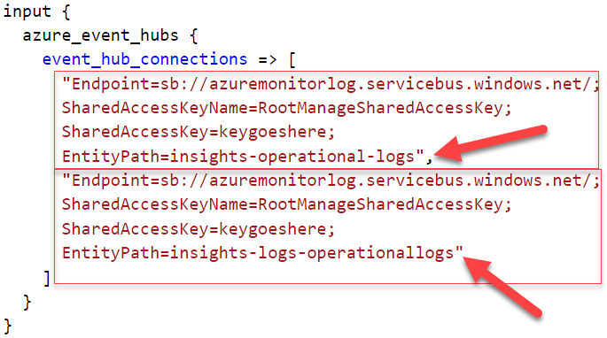
Azure Event Hubs
Microsoft cloud logging supports Event Hubs and Monitor
Real-time logging
Easy to integrate with SIEM
Requires secure key use
And proper access control lists (ACLs)
Notes:
https://azure.microsoft.com/en-us/services/event-hubs
https://docs.microsoft.com/en-us/azure/azure-monitor/overview

Slide 21
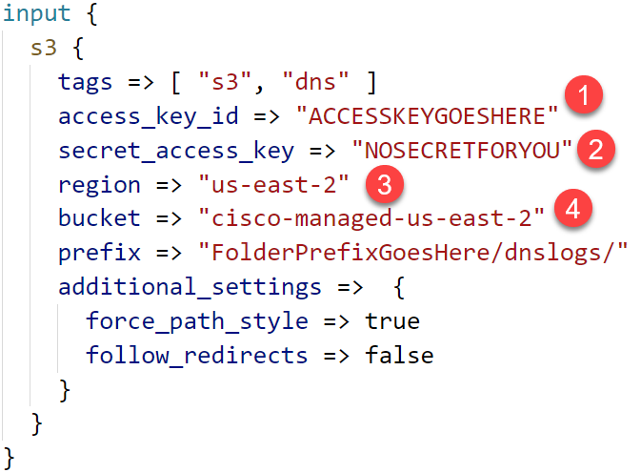
S3 Buckets
Similar methodology for S3
And CloudWatch
CloudTrail can log to either S3 or CloudWatch
Plugin access information into SIEM
Cisco Umbrella log example

Slide 22



Container Architecture
/var/log/apache2
Containers
/var/log/mysql
access.log
error.log
error.log
Apache
MySQL
mysql.log
mysql-slow.log
Apache
JavaApp
Nginx
Legacy
Docker Service
/var/log/upstart
docker.log
Host OS

Slide 23
Container Logging
Four common options for collecting logs from containers
Persistent data volume or bind mount
Example: S3 bucket, google storage bucket, etc.
Application inside container (custom coding)
Monitoring container (“sidecar”)
Daemon log drivers
Example: Amazon log driver to S3 or CloudWatch

Slide 24
API Logging
Major difficulty is dealing with APIs
Each is custom to vendor
Ideally, log solution natively supports application
Some vendors support Salesforce, Office 365, etc.
You likely will have SaaS applications without native support
No support for SaaS application = custom coding

Slide 25
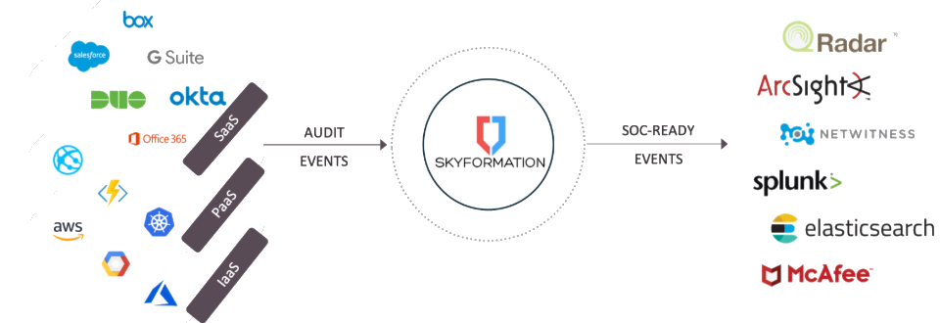
API Logging Alternatives
One option is to partner with professional service companies
They design solution to pull logs and send off
Also is possible to partner with vendor solution (can be pricey)
Example: Sky Formation is a SaaS log agent

Slide 26
Analysis
After collection it is time to put the logs to good use
Collection without looking at the data = BAD IDEA
Point of collection is to do something with it
Go back to discovery sheet to come up with initial ideas
Too many failed log ins vs. too many successful
Impossible time travelers (geo locations)
Sensitive data on endpoint where it should not be

Slide 27
Cloud Log Analysis Ideas
Some things to consider:
Legacy or unauthorized logins
Changes to external sharing policies
Unauthorized accounts or adding to sensitive groups
Large amount of files accessed or large data pulls
Standard user behavior analytics
Standard application analytics

Slide 28
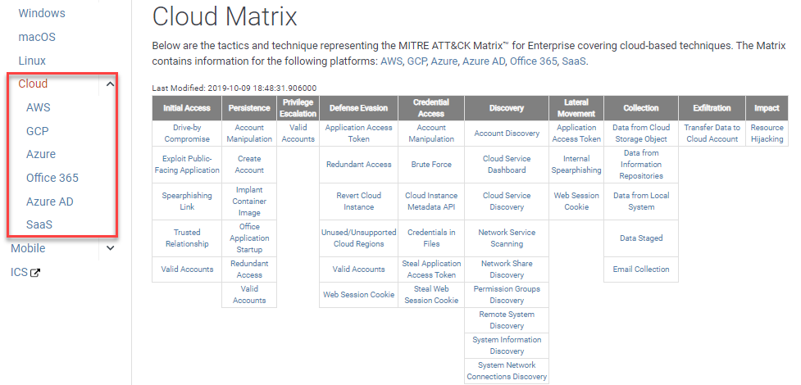
MITRE ATT&CK Cloud Matrix

Slide 29

Summary
Log analysis with cloud technologies
Discover
Collect
Analyze
Consider SEC555: SIEM with Tactical Analytics
Rumor is… There may also be a new course soon:
Tactical Data Handling at Scale with Logstash

Slide 30
